Slide 1
EXCEL REASSESMENT
MAROUF MUZAFFAR

Slide 2
Q1: TOP 5 CUSTOMERS BASED ON SALES
STEPS FOR SOLUTION:
1.PIVOT TABLE
2.SALES & CUSTOMER NAME
3.FILTER TOP 5
INSIGHTS
CANON IMAGE CLASS IS HAVING HIGHEST SALES
IN THE TOP 5 CATEGORY

Slide 3
Q2:TREND IN TOTAL SALES OVER THE YEARS
STEPS FOR SOLUTION:
PIVOT THAN YEAR WISE SALES
THAN USED LINE GRAPH TO SHOW THE DATA
YEAR 2017 = HIGHEST SALES
YEAR 2018 = LOWEST SALES
INSIGHTS
HERE WE CAN SEE THAT AFTER 2017 THE SALES
DROPPED FROM 730.9K TO 5.2K

Slide 4
Q3: TOP 5 CITIES WITH HIGHEST TOTAL PROFIT
New York City | 62036.9837
Los Angeles | 440.7579
Seattle | 29156.0967
San Francisco | 17507.3854
Detroit | 13181.7908
Lafayette | 10018.3876
Jackson | 7581.6828
City | Sum of Profit
New York City | 62037.0
Los Angeles | 30440.8
Seattle | 29156.1
San Francisco | 17507.4
Detroit | 13181.8
CITY WITH HIGHEST PROFIT
STEPS FOR SOLUTION:
PIVOT TABLE
THAN CITY
TOP 5 CITIES
THAN GRAPH
INSIGHTS
NEW YORK HAVING THE HIGHEST PROFIT
AND JACKSON LOWEST

Slide 5
Q4:
TOTAL SALES ACROSS REGIONS
Category | Sum of Sales
Furniture | 252612.7
Technology | 251991.8
Office Supplies | 220853.2
Grand Total | 725457.82
STEPS FOR SOLUTION:
PIVOT TABLE
REGION WISE SALES
FILTER REGION = WEST
INSIGHTS
IN WEST REGION FURNITURE IS HAVING HIGHEST SALES OF 252.6K AND ALSO
TECHNOLOGY IS HAVING ALMOST 252.0 K
SALES

Slide 6
Q5:
QUARTERLY GROWTH
STEPS FOR SOLUTION:
PIVOT TABLE
YEAR WISE AND QUARTER WISE
FILTER SALES IN DESC
INSIGHTS
QUARTER 4 IS HAVING HIGHEST GROWTH
WHICH COMES IN YEAR 2017

Slide 7
Q6:
TOP 5 CUSTOMERS
Customer Name | Sum of Sales
Sean Miller | 25.0K
Tamara Chand | 19.1K
Raymond Buch | 15.1K
Tom Ashbrook | 14.6K
Adrian Barton | 14.5K
Grand Total | 88.3K
CUSTOMER
WITH
HIGHEST
SALES
STEPS FOR SOLUTION:
PIVOT TABLE
CUSTOMER NAME AND IN VALUES SALES
FILTER TOP 5
INSIGHTS
SEAN MILLER IS THE CUSTOMER WITH HIGHEST SALES = 25K

Slide 8
Q7:
RETURNS
Category | No of Returnss
Office Supplies | 473
Furniture | 171
Technology | 156
Grand Total | 800
STEPS FOR SOLUTION:
XLOOKUP
THAN PIVOT TABLE
CATEGORY FILTER WITH YES
INSIGHTS
OFFICE SUPPLIES HAVING HIGHEST RETURNS
THE REASON FOR THE TREND LATE DELIVERY

Slide 9
Q8:
DISCOUNT VS SALES
correlation -0.02819 weak Negative correlation
STEPS
FIND CORRELATION USING FORMULA
PIVOT DISCOUNT AND SALES
USED SCATTER PLOT FOR THE SAME
INSIGHTS
THERE IS INCREASE IN SALES WHEN DISCOUNT IS HIGH
ALSO DECREASE WHEN DISCOUNT IS LOW

Slide 10
Q9:
POPULAR PRODUCT QUANTITY SOLD
Segment | Sum of Quantity
Furniture | 8028
Furnishings | 3563
Chairs | 2356
Tables | 1241
Bookcases | 868
Office Supplies | 22906
Binders | 5974
Paper | 5178
Storage | 3158
Art | 3000
Appliances | 1729
Labels | 1400
Fasteners | 914
Envelopes | 906
Supplies | 647
Technology | 6939
Phones | 3289
Accessories | 2976
Machines | 440
Copiers | 234
Grand Total | 37873
Segment | Sum of Quantity
Furniture | 8028
Furnishings | 3563
Chairs | 2356
Tables | 1241
Bookcases | 868
In furniture FURNISHINGS IS HAVING HIGHEST SALES

Slide 11
Q10:
SALES
Row Labels | Sum of Profit
Consumer | 134119.2
Corporate | 91979.1
Home Office | 60298.7
CONSUMER GENERATES THE MOST REVENUE

Slide 12
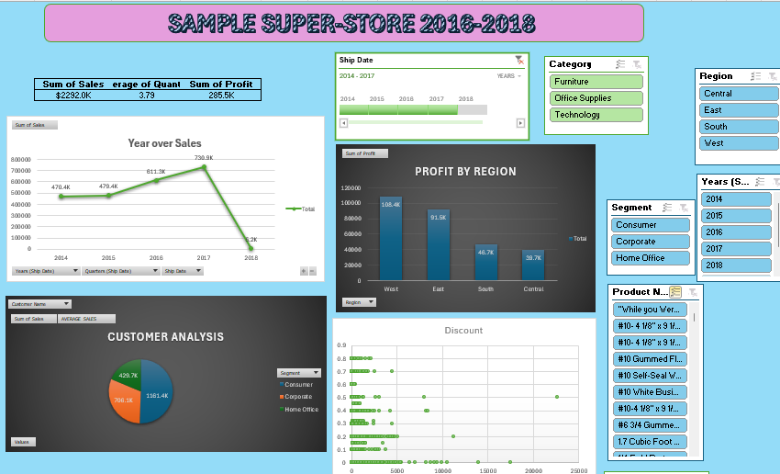
CREATED THE DASHBOARD ADDED SLICEERS ALSO AND
APPLIED ALL THE PARAMETERS AS GIVEN IN INSTRUCTIONS

Slide 13
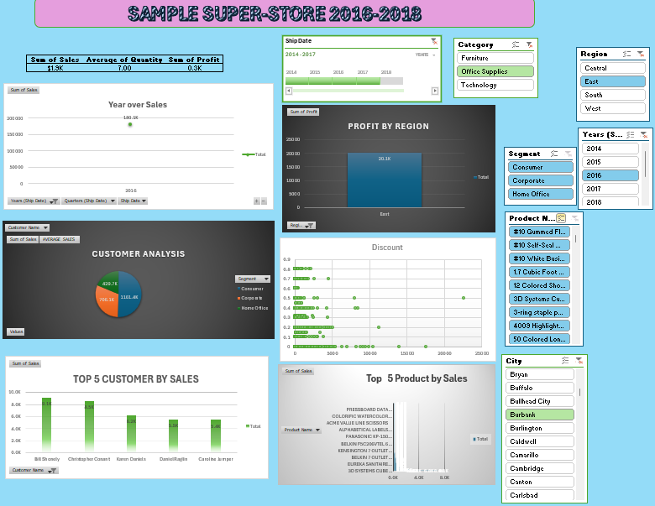
HERE I HAVE USED SLICERS AND DATA IN GETTING EFFECTED IN ALL GRAPHS

Slide 14


Slide 15
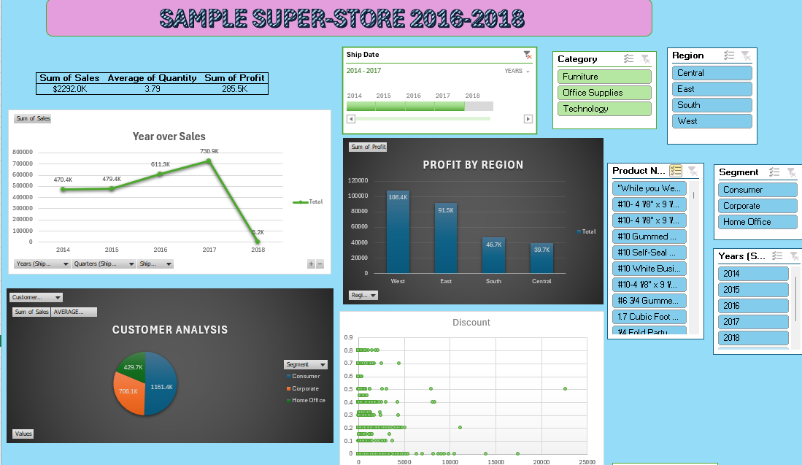

Slide 16
